Slide 1















Digital Portfolio
STUDENT NAME: R.VASUMATHI
REGISTER NO AND NMID: 2428b0253 AND F38B2567E7EB3718A2041FB143E27267
DEPARTMENT: B.SC COMPUTER SCIENCE WITH DATA ANALYTICS
COLLEGE: COLLEGE/ UNIVERSITY: TIRUPPUR KUMARAN COLLEGE FOR WOMEN
/BHARATHIYAR UNIVERSITY
1

Slide 2

PROJECT TITLE
MY DIGITAL PORTFOLIO
2

Slide 3





AGENDA
1.Problem Statement
2.Project Overview
3.End Users
4.Tools and Technologies
5.Portfolio design and Layout
6.Features and Functionality
7.Results and Screenshots
8.Conclusion
9.Github Link
3/21/2024 Annual Review
3

Slide 4

PROBLEM STATEMENT
Mental health disorders are a growing public health concern, yet many people
Still face stigma, misinformation, and limited access to care. Conditions like depression, anxiety, and
stress often go untreated, leading to reduced quality of life and long-term health consequences.
There is an urgent need to raise awareness, reduce stigma, and improve early intervention and
access to community-based psychological support system .This could involve a clinical issue like
helping clients manage anxiety, a professional challenge like navigating the job market, or a broader
societal problem that the psychologist aims to understand or solve. A strong problem statement
clarifies the scope of the work, highlights the need for the psychologist’s contribution, and provides a
clear focus for the portfolio’s content, often aligning with academic guidelines fro
organizations like the American Psychological Association (APA).
4

Slide 5

PROJECT OVERVIEW
This project aims to address the growing mental health needs within the
community by improving early identification intervention, and support for individuals
experiencing psychological distress. By combining clinical assessment, therapeutic interventions
and psychoeducational, the project seeks to reduce stigma, promote emotional well-being, and
enhance access to mental health services. A data-information approach will be used to measure
outcomes and guide continuous improvement in psychological care delivery.
Key objectives:
1. Increase awareness and reduce stigma through targeted psychoeducational programs.
2. Implement evidence based therapeutic approaches tailored to individual needs.
3. Improve access to mental health services, especially in underserved populations.
4. Monitor process and evaluate outcomes using psychological metrics and client feedback.
5

Slide 6



WHO ARE THE END USERS?
The end users of psychological services include individuals, families, students,
employees, and communities who seek guidance, therapy, and emotional support to improve
their mental well-being and quality of life.
Individuals – People facing stress, anxiety, depression, or other mental health issues.
Student & youth – Seek guidance for studies, career, peer pressure, and emotional well-being.
Families & couples – Need support for relationship challenges, parenting, and family conflict .
Employees & professionals – Require counselling for workplace stress, burnout, and work-life
balance .
Communities – Benefit from awareness programs, workshops, and group support to reduce
stigma.
6

Slide 7

TOOLS AND TECHNIQUES
Psychological Tests and Inventories : Examples : Beck Depression
Inventory (BDI), MMPI, State – Trait Anxiety Inventory (STAI).
Clinical Interview : Structured, semi – structured, and unstructured
interview to gather detailed patient history.
Neuropsychological Assessments : Tools like the WAIS or MoCA to
evaluate cognitive functions.
Counselling Techniques : CBI (Cognitive Behavioral Therapy), talk
therapy, relaxation methods.
Digital Tools : Brain imaging ( FMRI, EEG) for studying behaviour and
cognitive.
Supportive Technologies : Meditation apps, mood tracking apps, stress
management tools.
7

Slide 8

POTFOLIO DESIGN AND LAYOUT
Header : Contains the psychologists name, profession, and a brief tagline or message to
potential clients.
Navigation Bar : Provides links to the different sections on the page : About Me, Services,
Testimonials, and Contact.
About Me : A brief introduction, background, and approach to therapy.
Services : Lists the psychologists services such as individual therapy, couples counselling, and
family therapy.
Testimonials : Showcases quotes from clients to build trust and credibility.
Contact : Includes a simple from for client to contact the psychologists. Fields include name,
E-mail, and a message. Can be linked to a background script (e.g., PHP) to handle from
submission.
Footer : Simple copyright notice and any additional footer information.
Responsive Design :
The layout adapts for mobile and tablet screen using media queries. On smaller screens,
the grid layout for services and testimonials adjusts to a single column to ensure readability.
8

Slide 9
FEATURES AND FUNCTIONALITY
Features :
Personal Branding – Professional photo, tagline, and short bio. Specialization (e.g., clinical
counselling, educational).
Educational Background – Degrees and institutions. Specialized training and workshops.
Work & Clinical Experience – Therapy practices, counselling sessions, or reasearch projects.
Volunteer or community outreach work.
Publications & Research Contributions – Journal article, book chapters. Conference talks and
presentations.
Functionality :
Case Study Summarise (client - anonymized) – Problem →Approach →Outcome format
Media & Resources – Awareness posters, infographics. Recorded lectures , workshops, or
podcasts.
Interactive Elements – Timeline of career & achievements. Appointment request or contact
form.
Accessibility & Design – Mobile – friendly layout. Clear typography and soft color palette. Easy
navigation between sections.

Slide 10
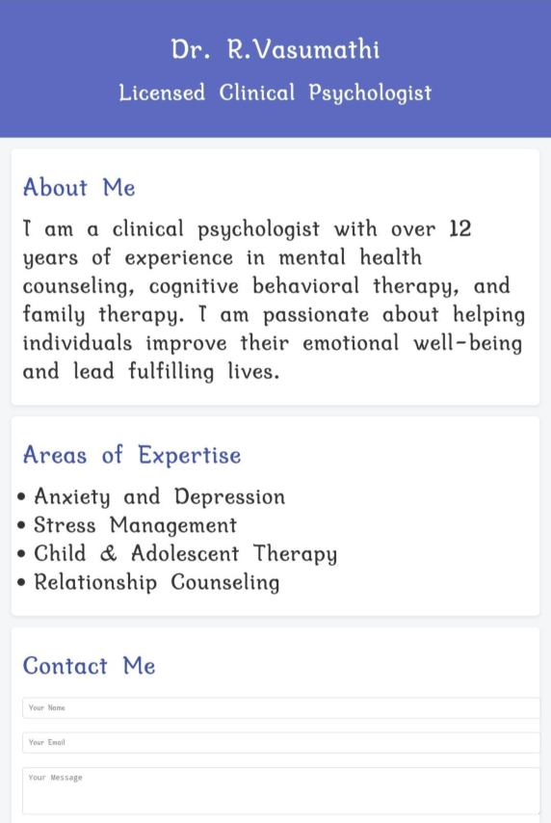

RESULTS AND SCREENSHOTS
3/21/2024 Annual Review
10

Slide 11
CONCLUSION
A psychologist’s portfolio conclusion should function as a metacognitive reflection,
synthesizing the learning and growth experienced throughout the portfolio’s creation, not just
summarizing the content. It should detail how you’ve evolved as a learner, thinker, and
practitioner by identifying key insights gained, assessing your strengths and weaknesses in the
field, and discussing future professional development goals, referencing specific coursework
or examples as evidence. In conclusion as a dedicated psychologist, I am committed to
fostering a safe, empathetic space for personal growth and mental well-being. With a
personalized approach, I guide individuals through their challenges and empower them to
lead fulfilling live. Feel free to reach out for support or to learn more about my services. I look
forward to helping you on your journey to healing.
11

